Slide 1
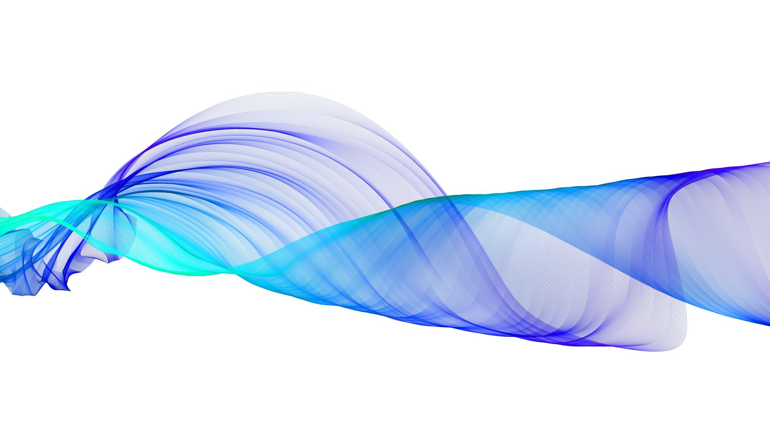
BREAST CANCER PREDICTION USING GENETIC ALGORITHM
Under The Guidance of
Mr. Amit Gupta Sir

Slide 2
Table of content
Introduction
Need for Research
Aim of Research
Methodology
Result Analysis
Conclusion
Future Prospect

Slide 3
INTRODUCTION
Breast cancer is one of the many types of cancers that have been diagnosed in humans. It is majorly detected in the females as compared to the males
This occurs when malignant tumors develop in the breast. These cells can spread by breaking away from the original tumor and entering blood vessels or lymph vessels, which branch into tissues throughout the body. When cancer cells travel to other parts of the body and begin damaging other tissues and organs, the process is called metastasis.

Slide 4
Methods of Diagnosis
Biopsy
Genetic Testing
Ultrasound
Fine Needle Aspiration
Magnetic Resonance Imaging

Slide 5
NEED for RESEARCH Facts of Breast
Facts of Breast
Cancer On average, every 2 minutes a woman is diagnosed with breast cancer and 1 woman will die of breast cancer every 13 minutes.
Every year around 11,500 women and 80 men die from breast cancer in the UK – that’s nearly 1,000 deaths each month, 31 each day or one every 45 minutes.

Slide 6
AIM of RESEARCH
To design a model that can increase diagnostics accuracy rate
Increase survival rate by early diagnostics
Reduce misdiagnosis
Help fast evaluation of test results

Slide 7
METHODOLOGY
Obtain
Obtain data for evaluation
Apply
Apply feature selection
Design
Design classification models
Evaluate
Evaluate the data based on these models
Compare
Compare results to find the best mode

Slide 8
Feature Selection
Principal Component Analysis (PCA) is used for understanding the data in a better manner.
It explains the correlation of features present in the dataset with the target variable.
It gives an insight on which features are bound to derive more accurate result and which do not.

Slide 9
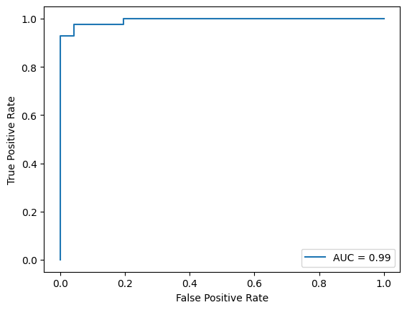
Adaptive Boosting
Adaptive boosting is a type of boosting algorithm.
It uses error learning model, i.e., it learns from the error generated in the last stump to calculate a better stump model.
In case of this research, on application the accuracy and the sensitivity observed are 98.25% and 100% respectively.

Slide 10
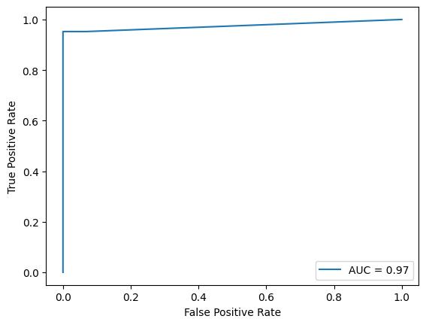
K-Nearest Neighbour
The new value for the missing data is calculated using distance calculating methods depending upon the type of distance being calculated.
It evaluates the values based on the nearest neighbor value. In case of high value of K then more than one neighbors are considered.
In case of this research, on application the accuracy and the sensitivity observed are 98.25% and 100% respectively.

Slide 11
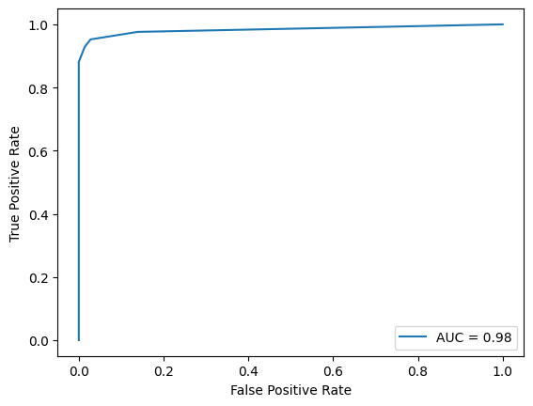
Bagging classifier
Bagging, also known as Bootstrap aggregating, is an ensemble learning technique that helps to improve the performance and accuracy of machine learning algorithms.
It is used to deal with bias-variance trade-offs and reduces the variance of a prediction model.
Bagging avoids overfitting of data and is used for both regression and classification models, specifically for decision tree algorithms.

Slide 12
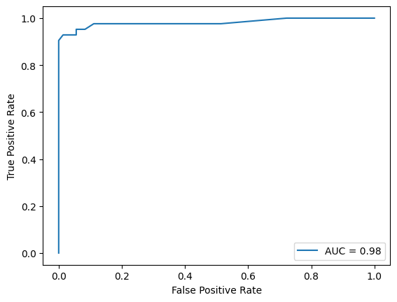
Random Forest
Forest is an extended version of Decision Trees. It is a group of individual decision trees combined together to form a forest.
It computes on a randomly selected data and compares this with all the decision trees that are present. The most frequent output obtained is considered to be the final result.
In case of this research, on application the accuracy and the sensitivity observed are 98.25% and 100% respectively

Slide 13

Support Vector Machine
This algorithm performs the computation by placing the data point on a hyperplane and evaluating the calculating the soft margins.
It can evaluate the data points of n-dimensions and allows easy understanding of data points.
In this case we calculate the accuracy and sensitivity of model with and without applying Kernel for tuning the parameters.
For general SVM we have accuracy and sensitivity calculated as 98.25% and 98.65% respectively.
And for SVM with RBF kernel accuracy and sensitivity calculated as 99.12% and 100% respectively.

Slide 14
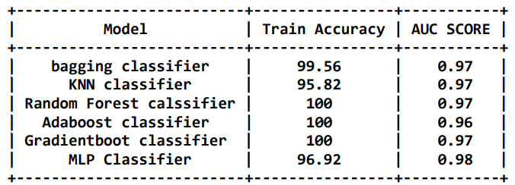
RESULT ANALYSIS

Slide 15
CONCLUSION
Based on the results obtained it can be concluded that SVM performs the best with an accuracy of 99.12% and sensitivity of 100%.
Apart from SVM, Adaboost and Random Forest algorithms performed significantly well with accuracy of 98.25% each as compared to KNN and Logistic Regression.

Slide 16
FUTURE PROSPECT
As we have seen Support Vector Machine model delivers optimal results which are imperative for early detection of cancer. As for the future prospect of this model goes, the aim is to find solution for that one error that was generated. Since the data used for this analysis isn’t a global data, it will be interesting to use this model to evaluate a more recent and big data which can help in realizing the real efficiency of this model.
The goal is to devise a model which will be able to analyze and produce 100% accurate results for diagnostics and prognosis of breast cancer. As it is the need of the hour, given the rise in the no of patients being detected with breast cancer it is critical to create such model which can improve the method and decrease the time spent in diagnosing the symptoms. This could be achieved if we are able to diagnose the symptoms based on other common factors like blood count etc.

Slide 17

THANK YOU

